Slide 1


Child Abuse Prevention Panel
April 3, 2017
Proudly hosted by
When it comes to kids…
We Never Quit.
Childlawcenter.org

Slide 2
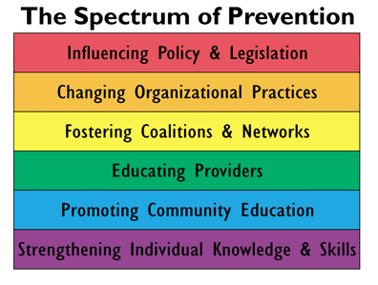
How Do you Prevent Child Abuse from Ever Occurring in the First Place?

Slide 4

IDENTIFY
INTRODUCE
IMPLEMENT
ENSURE
Improving the health and well-being
of vulnerable Colorado children and families

Slide 5

OUR PROGRAMS:
Nurse-Family Partnership®
The Incredible Years®

Slide 6
Nurse-Family Partnership®
(aka Nurse Home Visitor Program)
A relationship-based proven program that partners professional nurses with vulnerable first-time mothers and their babies to achieve:
Improved pregnancy outcomes by helping women engage in preventive health practices, including thorough prenatal care from their healthcare providers, improving their diets, and reducing their use of cigarettes, alcohol and illegal substances
Improved child health and development by helping parents provide responsible and competent care
Improved economic self-sufficiency of the family by helping parents develop a vision for their own future, plan future pregnancies, continue their education and find work
Notes:
In 1999, our founders chose Nurse-Family Partnership, a program that pairs nurses with first-time, low-income moms who make in-home visits starting early in pregnancy through the second birthday of the child. Thirty seven years of research has shown the program to improve the healthy pregnancy outcomes, healthy early development of the child, and the long-term self-sufficiency of the family. The early years of successfully implementing NFP allowed for the development of our successful implementation model and ultimately a vision to offer a menu of evidence-based early childhood programs in Colorado. In 2002, we conducted a readiness assessment to identify community needs not being met by NFP or the continuum of existing services in each community. We consistently heard the greatest need was school readiness and specifically the social-emotional development of young children related to their school readiness. This was supported by research and led to a second national program search in which we selected The Incredible Years®.
Expulsion and Suspension issues that still haunt our young children/teachers today

Slide 7
The Incredible Years®
A proven early childhood emotional and social health program designed to increase a child’s success at school and at home by promoting positive parent, teacher, and child relationships. The 3 components are:
Teacher Classroom Management: Teachers learn positive teaching strategies, effective classroom setup, and how to support children with challenging behaviors.
Dinosaur School: 60 sessions led by early childhood teachers with focus on how to solve problems, control one’s anger, self-monitor one’s emotions, succeed in school, and make friends.
Parenting Program: 14 weekly sessions to help parents learn strategies for increasing positive parenting (i.e.: setting effective limits) and decrease negative parenting practices (i.e.: physical punishment).

Slide 8
The Incredible Years® – Research
Research on IY began in 1982 at the University of Washington by the program developer, Dr. Carolyn Webster-Stratton. Numerous randomized control group trials have been conducted over three decades by independent investigators.
Increases in children’s emotional literacy, social skills, problem solving, compliance and school readiness
• Increases in proactive classroom management strategies and teacher-parent collaborative partnerships and reductions in stress
• Reductions in parental depression and stress; increases in positive family communication and problem solving, nurturing parenting interactions, and replacing harsh discipline with proactive methods; increases in school involvement

Slide 9
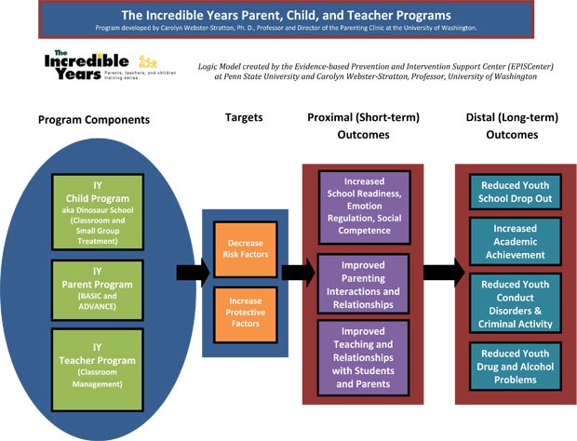
Teacher Program
Child Dinosaur Program: Treatment
Child Dinosaur Program: Classroom
ADVANCE Parent Program
ACADEMIC Parent Program
3/00

Slide 11
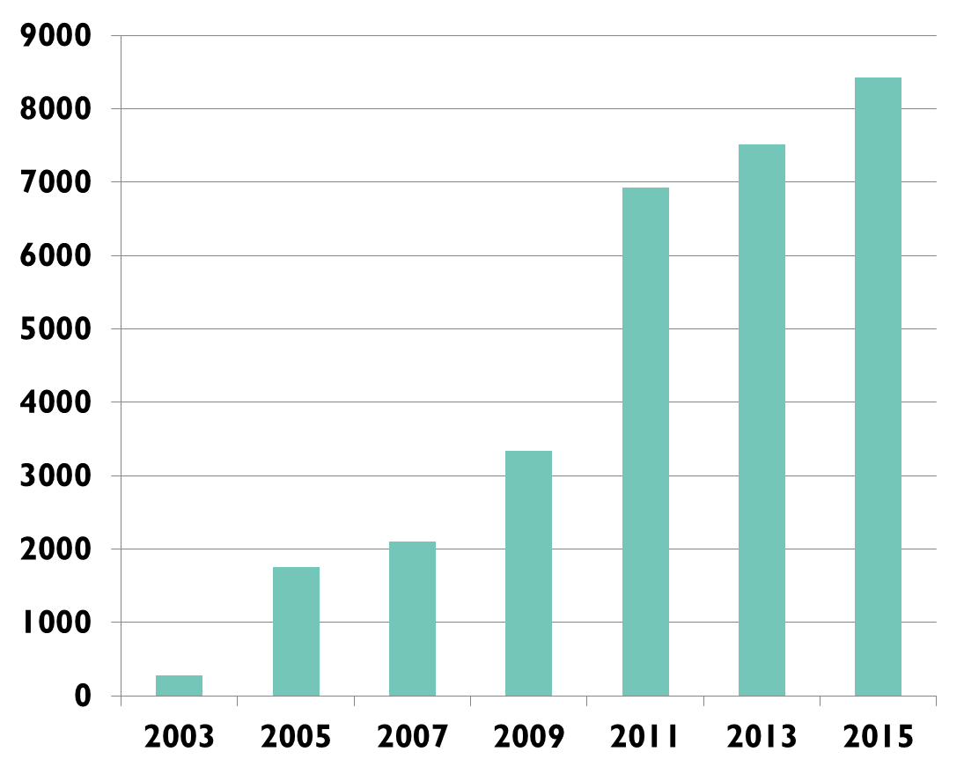
IY GROWTH AND OPPORTUNITY
67k children & parents served
11% penetration
Notes:
High demand – varying penetration in 23 counties – but just 11%, a long way to go.

Slide 12
2016 Colorado Outcomes
Statistically significant changes in:
Children’s social competence - Prosocial/Communication Skills, Emotion Regulation Skills and Academic Skills
Parent’s increased use of positive parenting, including: Appropriate Discipline, Positive Verbal Discipline, Monitoring, Clear Expect/Praise
Parent’s decreased use of negative parenting, including: Harsh and Inconsistent Discipline and Physical Punishment
Teacher/Parent Satisfaction:
84% of teachers report program met social emotional development goals
97% of parents report improvement in problem that they enrolled to address
Return on Investment:
Colorado Results First estimates that this program avoids $4.13 in future costs for every dollar invested.

Slide 13



A STRATEGIC PARTNERSHIP

Slide 14
Illuminate Colorado prevents child maltreatment and builds strong families through education, advocacy, and family support.
Notes:
Today we are going to focus on EDUCATION and highlight two specific projects to illustrate activities within the spectrum of prevention.
-- Promoting Community Education discussing Child Abuse Prevention Month
-- Educating Providers with an overview of Child Sexual Abuse Prevention Efforts

Slide 15

Notes:
As you may know, April is Child Abuse Prevention Month.

Slide 16


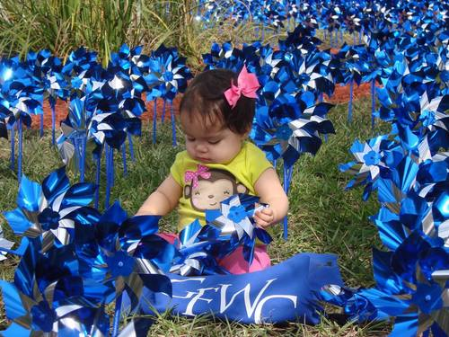
Notes:
In 2008, Prevent Child Abuse America introduced the pinwheel as the new national symbol for child abuse prevention through Pinwheels for Prevention®. What our research showed, and what our experiences since then have borne out, is that people respond to the pinwheel. By its very nature, the pinwheel connotes whimsy and childlike notions. In essence, it has come to serve as the physical embodiment, or reminder, of the great childhoods we want for all children.

Slide 17
Ways to Engage
Wear Blue This Friday – April 7th
Join us on the West Steps Tomorrow at 11am
Plant a Pinwheel Garden
Offer to help a family in your community
Promote on Social Media
#co4kids & #pinwheels4prevention
Attend local community events

Slide 18
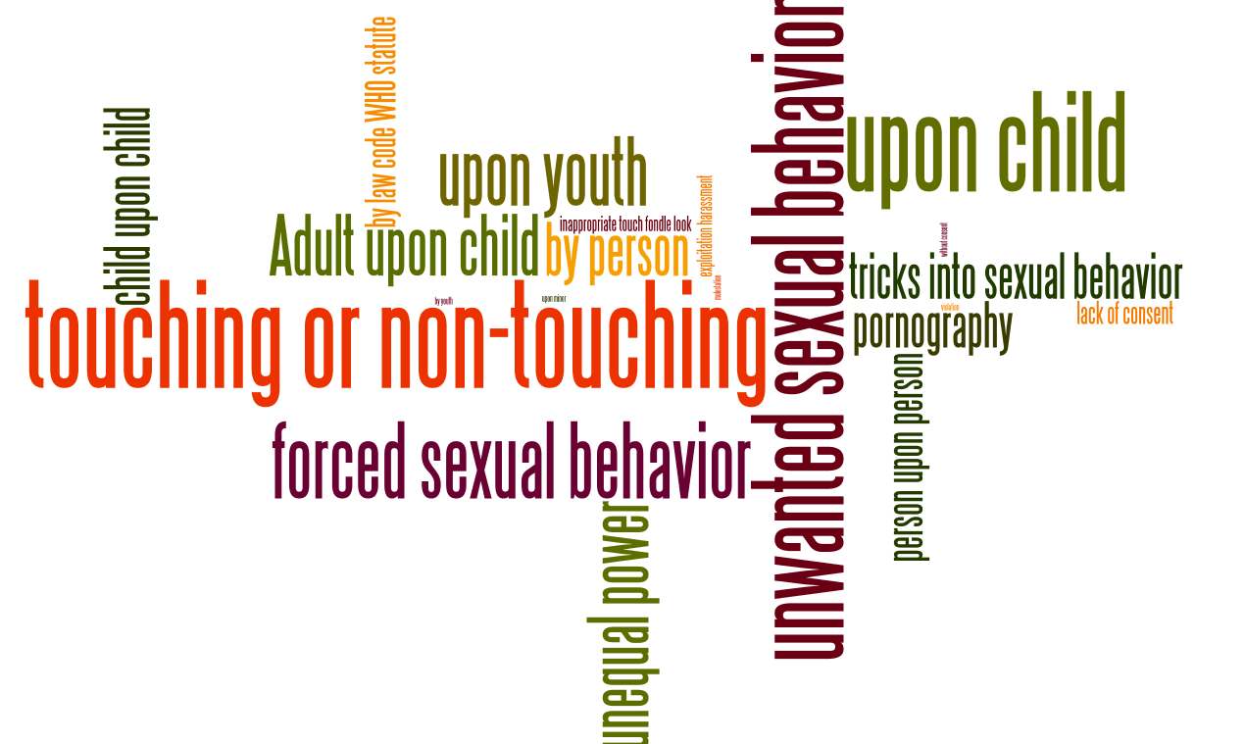
Child Sexual Abuse Prevention
Notes:
The involvement of a child or youth (aged 0-18) in sexual activity he or she does not fully comprehend, is unable to give informed consent to, or for which he or she is not developmentally prepared, or else that violates the laws or social taboos of society. Children can be sexually abused by adults, youth or other children who have power or perceived power in the relationship– by virtue of authority, physical ability or disability, age or stage of development, trust, or responsibility.
Sexual abuse of children or youth includes sexual contact that is accomplished by force or threat of force, regardless of the age of the participants, and all sexual contact between an adult or youth and a child, regardless of whether there is deception or the child understands the sexual nature of the activity. Sexual contact between children also can be abusive if there is a significant disparity in age, development, or size, rendering a child or young person incapable of giving informed consent. The sexually abusive acts include, but are not limited to, sexual penetration, sexual touching and trafficking; non-contact sexual acts include, but are not limited to such acts as exposure or voyeurism. Sexual exploitation such as purposeful exposure and participation in pornography is part of the breadth of sexual abuse of children and youth.

Slide 19
Educating Providers
  Address full spectrum of prevention, from teaching adults about healthy sexual development in children and teens to identifying concerning behaviors to responding appropriately to a disclosure
  “Any and all ages are subject to the potential of sexual abuse. Conversations need to start early, be age appropriate and become a normal part of raising our children in to healthy adults.”

Slide 20

Stewards of Children, a program by Darkness to Light, is the only nationally available program scientifically proven to increase knowledge, improve attitudes and change child-protective behaviors. This revolutionary program is for any responsible adult who cares about the welfare of children and particularly appropriate for training staff and volunteers of youth-serving organizations (sports leagues, day care centers, after school programs, children’s clubs, church groups).

Slide 21

Nurturing Healthy Sexual Development
A comprehensive approach to preventing child sexual abuse ensures adults interacting with children possess the basic knowledge and skills to support healthy growth and development in children.
Notes:
Designed for parents, teachers, early childhood educators, childcare providers, home visitors, and community members, NHSD is designed to foster healthy, nurturing relationships that support the healthy development of children and empower adults to communicate with children about sexuality in age and role appropriate ways.

Slide 22

Our Mission is to ensure that our Members are strong and optimally equipped to serve Colorado families.
Connecting Resources, Impacting Lives
Family Resource Center Association
provides public advocacy, capacity building, and resource development to strengthen its statewide network of Family Resource Centers as they bring help and
hope to Colorado families.

Slide 23

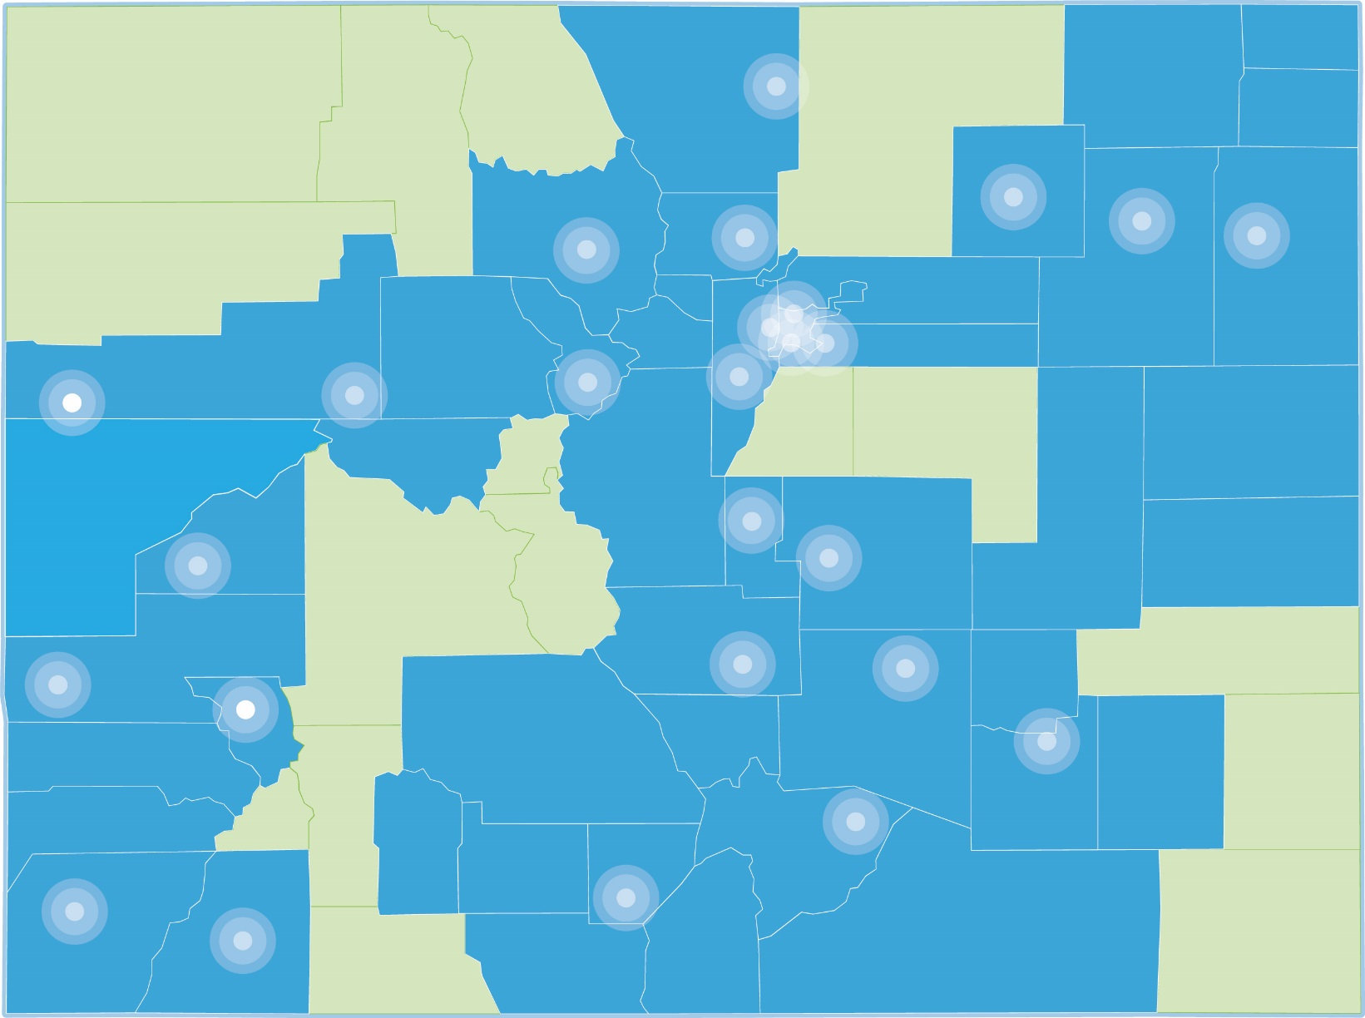
Our FRCA Member Centers March 2017

Slide 24


WHAT IS A FAMILY RESOURCE CENTER?
Family Resource Centers provide a safe, accessible place for children and families to connect with comprehensive, coordinated services that help them strengthen their families and become more self-reliant.
Programs at each center are tailored to the culture, resources and needs of the community they serve and focus on building on the strengths of each family and individual. Family resource centers adhere to the Principles and Practices of Family Support established by Family Support America and the Strengthening Families Protective Factors.
Notes:
SERVICES FREQUENTLY PROVIDED AT FAMILY RESOURCE CENTERS
Family goal-planning and strengthening
Parent education and home visitation programs
Early Childhood Programs (school readiness, before/after school, screenings)
Child Abuse Prevention Programs
Health Coverage Assistance and Enrollment (Medicaid, CHP+)
Healthy Living Programs (nutrition, exercise including adult and youth)
Basic Needs: food, clothing, utility and housing assistance
Employment: life skills, job readiness, GED/ESL classes, computer skills

Slide 25


Families face barriers to early childhood success
FRCA & FRCs reduce barriers for families
Family Resource Centers (FRCs) provide a single point of entry for families to access diverse services.
FRCs work with children and parents in a comprehensive, coordinated way to achieve family stability.
When families set their own goals, the change is more sustainable and lasting.
Children in stable homes are more likely to experience healthy growth and cognitive development.
National Scientific Council on the Developing Child (2007). The Science of Early Childhood Development. www.developingchild.net.
“Two-thirds of people who escape poverty will return to poverty
within 5 years”
The Urban Institute (2009). Understanding Poverty. www.urban.org
“Many service agencies work in silos making it hard for families to navigate getting the resources necessary for family stability”
www.liftcommunties.org

Slide 26
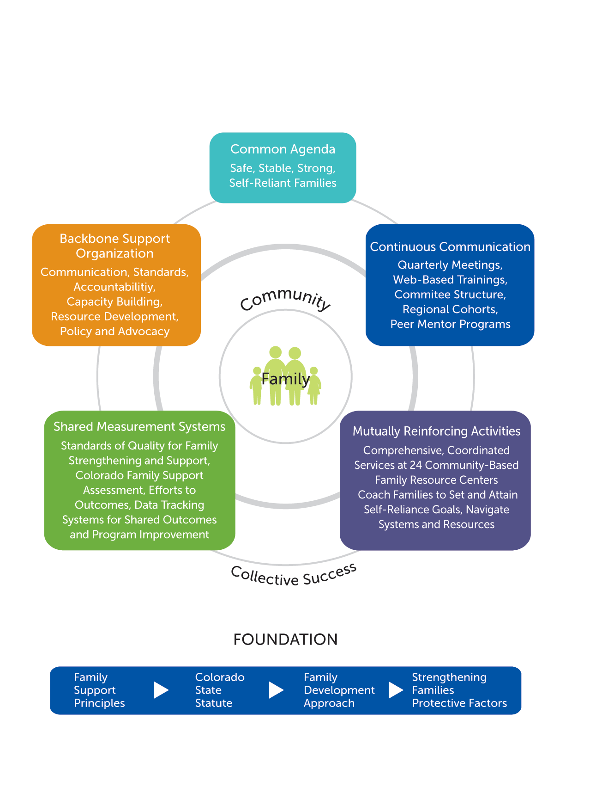
Colorado Family Resource Center Model

Slide 27

Community Coalitions and Statewide Networks
Early Childhood Councils
HB 1451-Collaborative Management Programs
Resource & Referral Networks
Strengthening Families Network
Early Childhood Colorado Partnership
Social Determinants of Health Learning Collaborative
Prevention Steering Committee

Slide 28
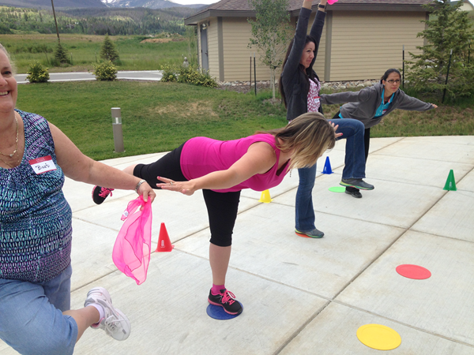

Benefits of FRCA Membership
Networking with other family resource centers across the state, including statewide and regional meetings
High quality training (Quality Standards and Motivational Interviewing) and technical assistance to increase center’s organizational capacity and service delivery
Representation of member centers and families they serve before the Colorado state legislature and other state agencies
Eligibility to participate in FRCA funding opportunities
Peer sharing of best practices in program and service delivery
Use of group memberships, like MSEC
ETO database usage and joint evaluation
of selected programs through shared tools
CATCH Train the Trainer in Summit County

Slide 29


Essentials for Childhood
Creating Safe, Stable, Nurturing Relationships and Environments for Children
Giorgianna Venetis
Child Maltreatment Prevention Manager

Slide 30
What is Essentials for Childhood?
Focus is on promoting safe, stable, and nurturing relationships and environments
Advance policy and community approaches to:
  Increase family-friendly employment (FFE) practices across Colorado
  Increase access to childcare and out-of-school-time care for children
  Increase access to high-quality preschool and full-day kindergarten
  Improve social and emotional health of mothers, fathers, caregivers and children
Notes:
CM prevention project focused on promoting strategies communities can consider to promote relationships and environments that help children grow up to be healthy productive citizens.

Slide 31





What are Essentials for Childhood Goals?
Raise awareness and commitment to promote safe, stable, nurturing relationships and environments
Use data to inform actions
Create the context for healthy children and families through norms change and programs
Create the context for healthy children and families through policies

Slide 32
Potential Outcomes
Improvements in children’s health, development, and health insurance coverage
Reductions in physical abuse of children
Reductions in child neglect
Reductions in unintentional or undetermined causes of childhood injury
Reductions in maternal depression and parental stress
Reductions in adolescent risky health behaviors
Reductions in chronic disease among adults and leading causes of death
Notes:
Strengthening Economic Supports!
One of the topics the Colorado EfC project has decided to focus on is the implementation of family-friendly employment
Rationale: Policies that improve the socioeconomic conditions of families tend to have the largest impacts on health.34 Strong empirical evidence consistently links low income to children’s development, academic achievement, and health,35,36 including exposure to child abuse and neglect.37 Policies that strengthen household financial security can reduce child abuse and neglect by improving parents’ ability to satisfy children’s basic needs (e.g., food, shelter, medical care), provide developmentally appropriate child care, and improve parental mental health. Policies can change the context for families by improving the balance between work and family (“family-friendly work”), thereby allowing parents to provide the necessary care for children and increasing the likelihood that children experience safe, stable, nurturing relationships and environments. Studies show several “family-friendly” work policies reduce risk factors for child abuse and neglect, such as stress and depression.

Slide 33
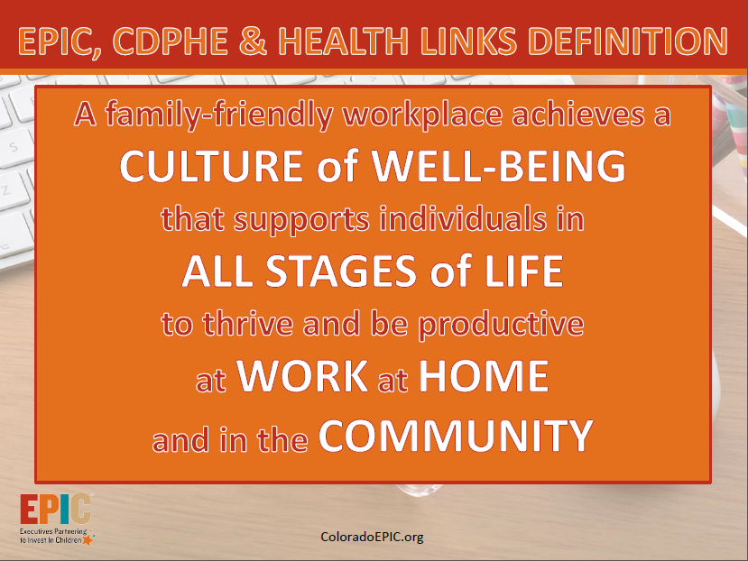

Slide 34
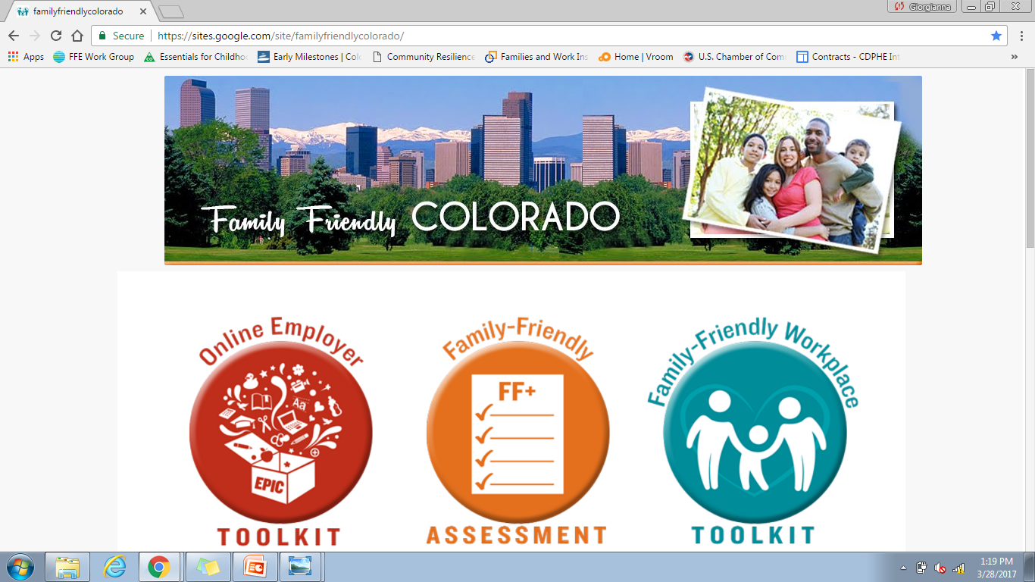
Approaches

Slide 35
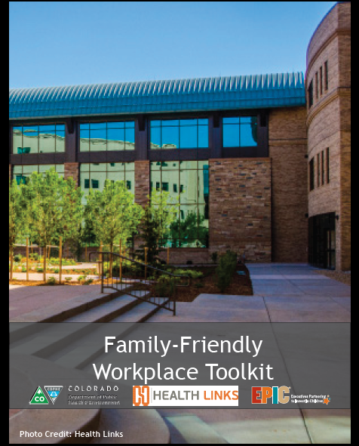
Family-Friendly Workplace Toolkit

Slide 36

Toolkit Examples
A family-friendly workplace offers
  A culture of flexibility
  Core benefits
  Paid Leave
  Supportive services and resources
  Career development
  Community involvement

Slide 37
Business Forums
Desired Outcomes:
Increased understanding of family friendly employment practices and how they support stronger children, families, and a more productive workforce.
Partners complete the family friendly workplace assessment and consider how it can be useful for enhancing family friendly policies in their workplace.
Partners consider how the ECCP can support ongoing learning and action among partners desiring to improve family friendly policies in their workplaces.
Notes:
Via pre-survey we learned a lot of people want to make a difference in their workplaces but aren’t totally sure where to start
Overall summary (i.e. small changes make a big difference!)
Survey Results: Generally, they are very positive, with 24/28 saying they are “highly likely to recommend” the event to others. On average, attendees felt their organizations were pretty family-friendly (mean 7 out of 10) and were fairly confident (mean 7 out of 10) in their personal ability to make change.
It was great to see the concrete plans folks had to make changes in the next week, month, quarter and year. Will be interesting to see what our 4-month follow-up finds. Cost is the major barrier. Lots of interest in the various resources we listed, “Data about the cost of changing policies and practices” being the most requested (20 out of 25). A few comments that the event was too short, they wanted more time to interact and discuss (which I see as a strong indication that people found it valuable!)

Slide 38

Upcoming Events
Forum on Family 2.0
Thursday, June 1st at 7:30-9:00 am
Children’s Hospital Colorado
Forum on Family
Wednesday, June 7th at 7:30-9:00am
Colorado Mesa University

Slide 39

Panelist Contact Information
Kendra Dunn
Child Maltreatment Prevention Director
Office of Early Childhood, Colorado Department of Human Services
kendra.dunn@state.co.us
Lisa Hill
Executive Director
Invest in Kids
lhill@iik.org
Jade Woodard
Executive Director
Illuminate Colorado
jwoodard@illuminatecolorado.org
Mark Kling
Executive Director
Family Resource Center Association
mkling@cofamilycenters.org
Giorgi Venetis
Child Maltreatment Prevention Manager
Colorado Department of Public Health and Environment
giorgianna.venetis@state.co.us

