Slide 1
COURT APPOINTED SPECIAL ADVOCATES
A CHILD’S LIFE LIFTED
CASA Day at the Capitol - 2017

Slide 2
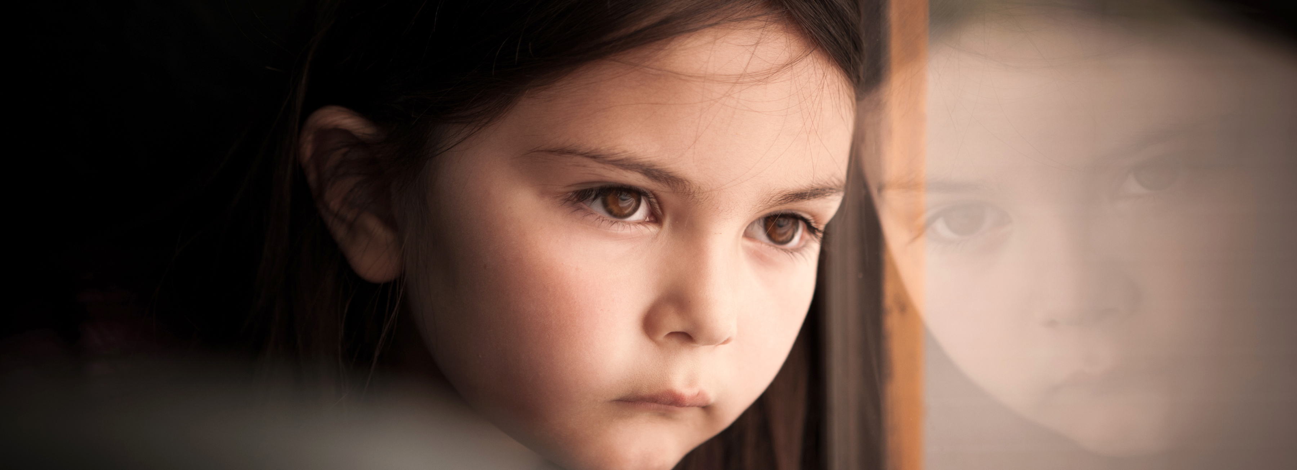

Slide 4
Hundreds of local children
need a CASA

Slide 5
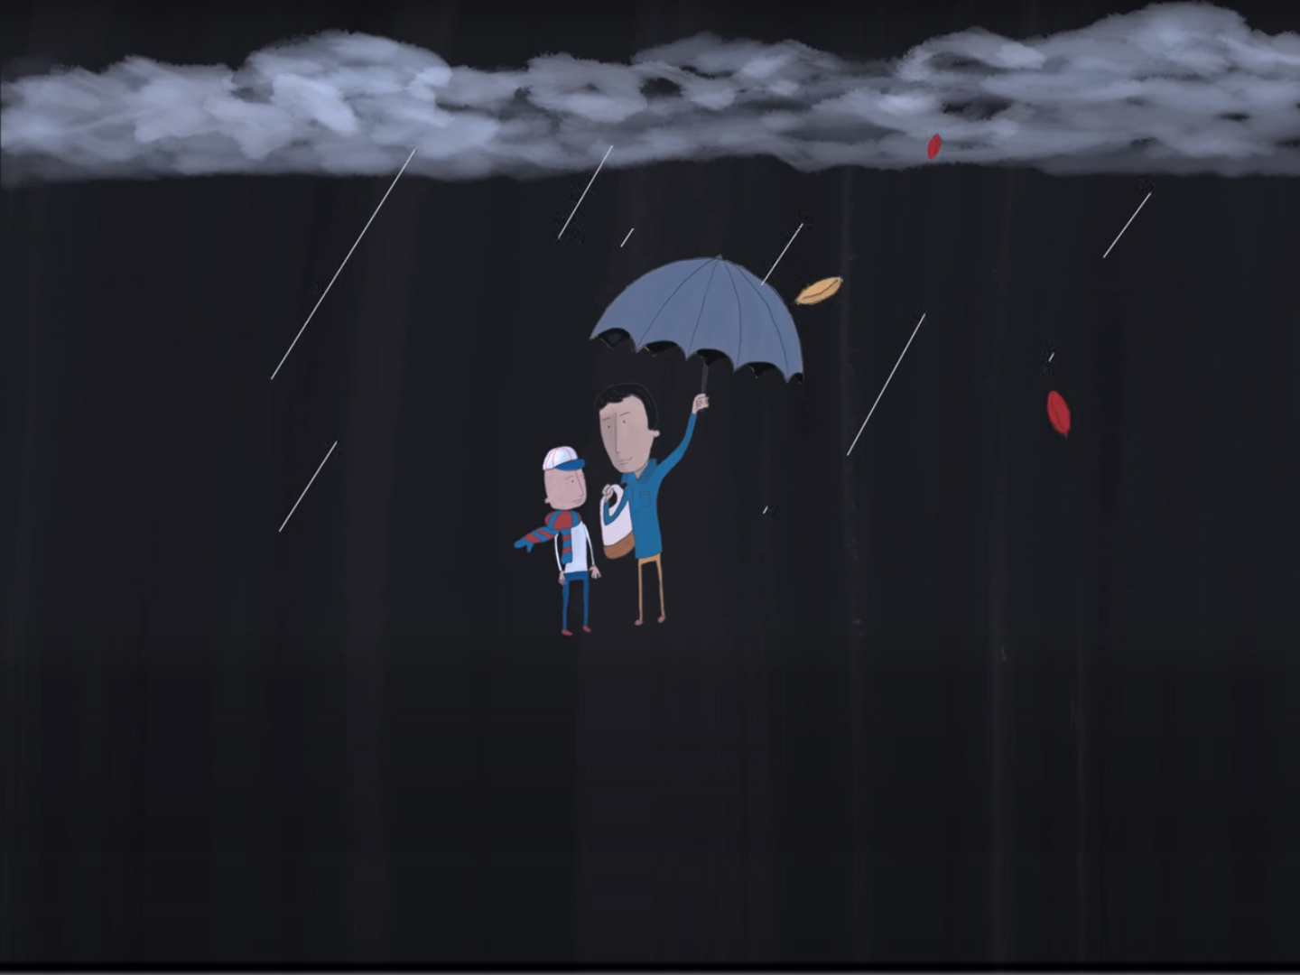

Slide 6
A child with a volunteer is more likely to find a safe, permanent home;
More likely to be adopted.
Half as likely to re-enter foster care.
Substantially less likely to spend time in long-term foster care.
More Likely to have a plan for permanency, especially children of color.
CASA costs approx. $1,700/child/yr.
Foster care costs approx. $26,000/child/yr.

Slide 7
Children with CASA volunteers do better in school.
Four times more likely to graduate from HS.
More likely to pass all courses.
Less likely to have poor conduct in school.
Less likely to be expelled.

Slide 8
Children with CASA volunteers
do better on 9 protective factors:
Neighborhood resources
interested adults
sense of acceptance
controls against deviant behavior
models of conventional behavior
positive attitude towards the future
valuing achievement
ability to work with others
ability to work out conflicts

Slide 9
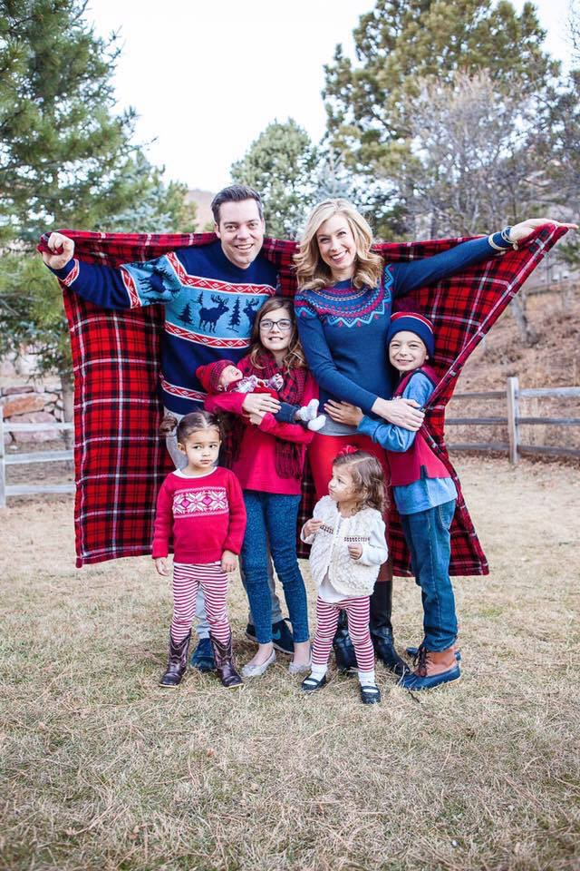
A Focus on CASA
Our Story: Humanizing how children of abuse & neglect come into the system.

Slide 10
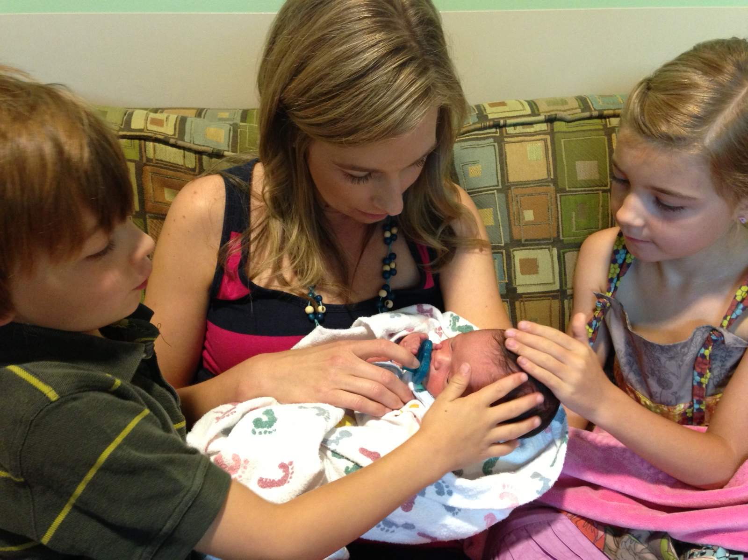
The Story of
Millie Miracle

Slide 11
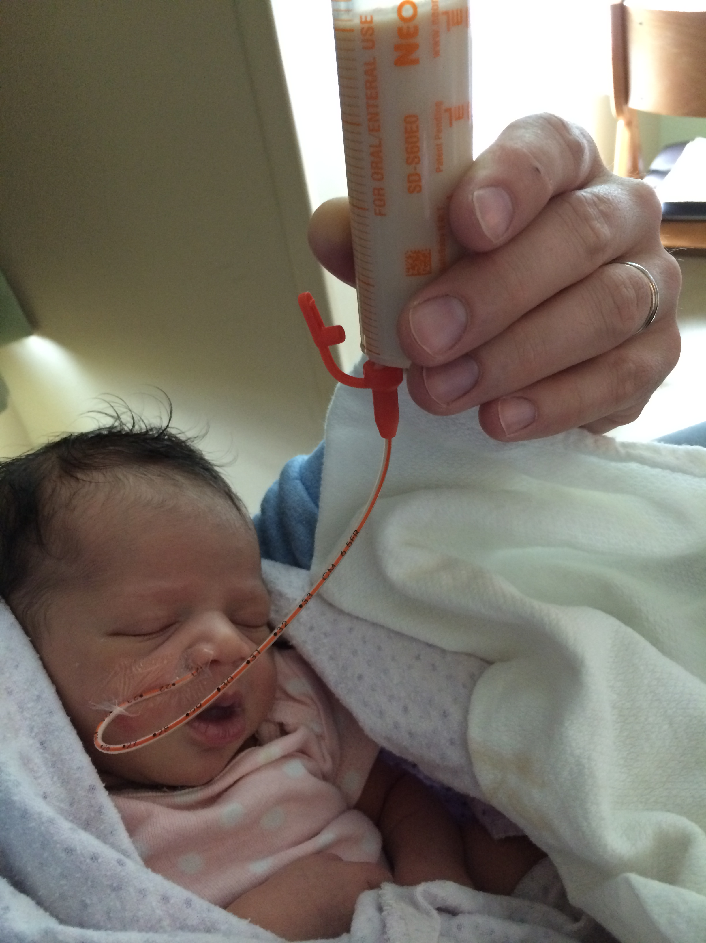
The Story of
Poppy Faith
How Our CASA
Advocate Made
The Difference

Slide 12
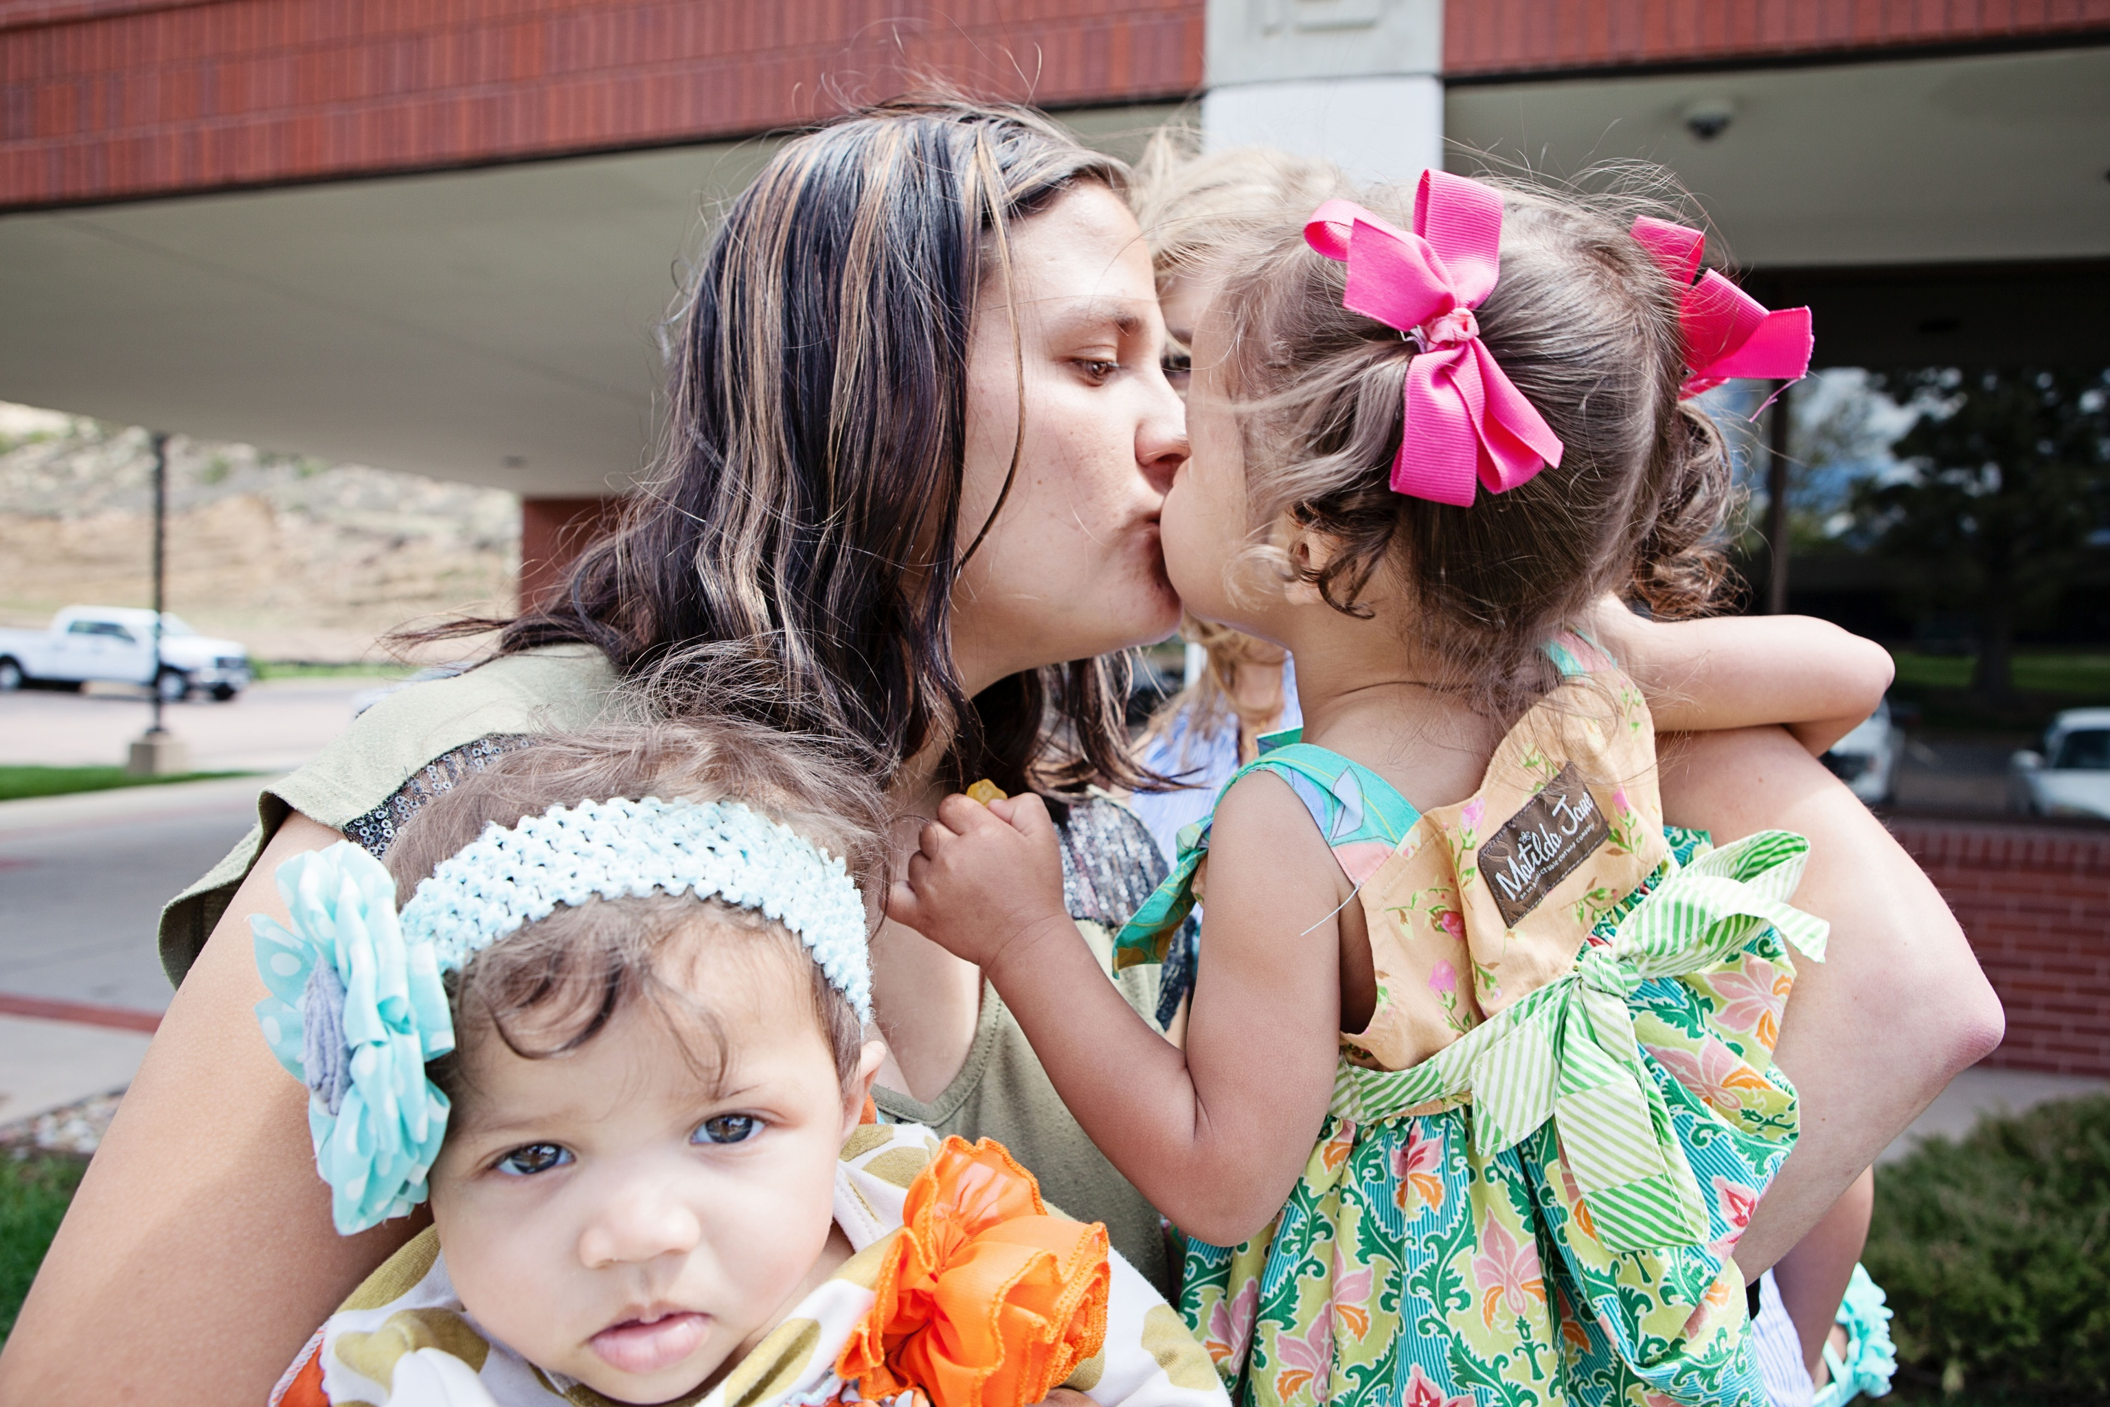
Saying Goodbye

Slide 13
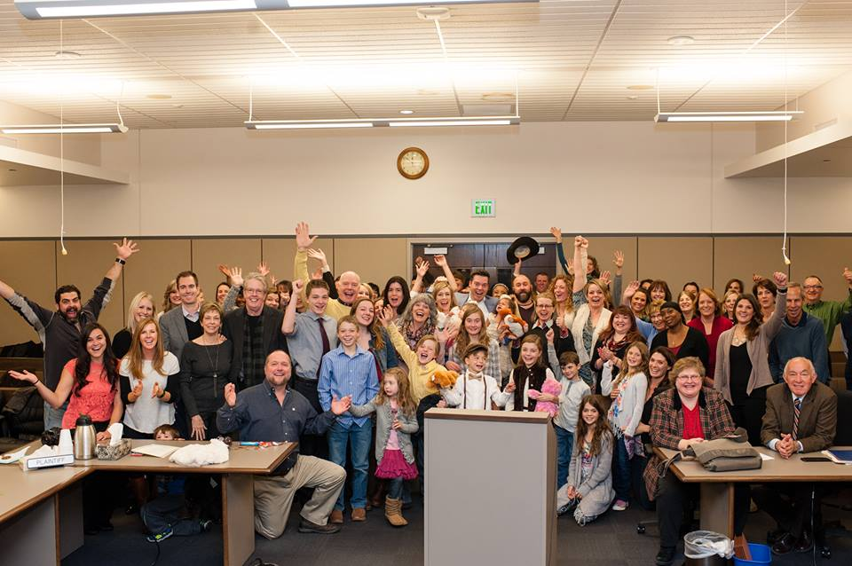
Our Adoption Day

Slide 14
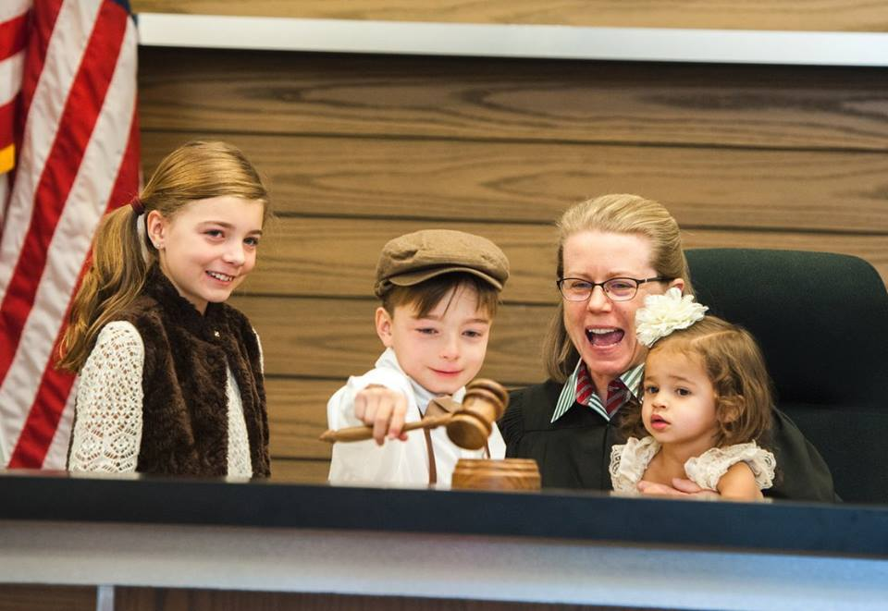
Our Adoption Day

Slide 15
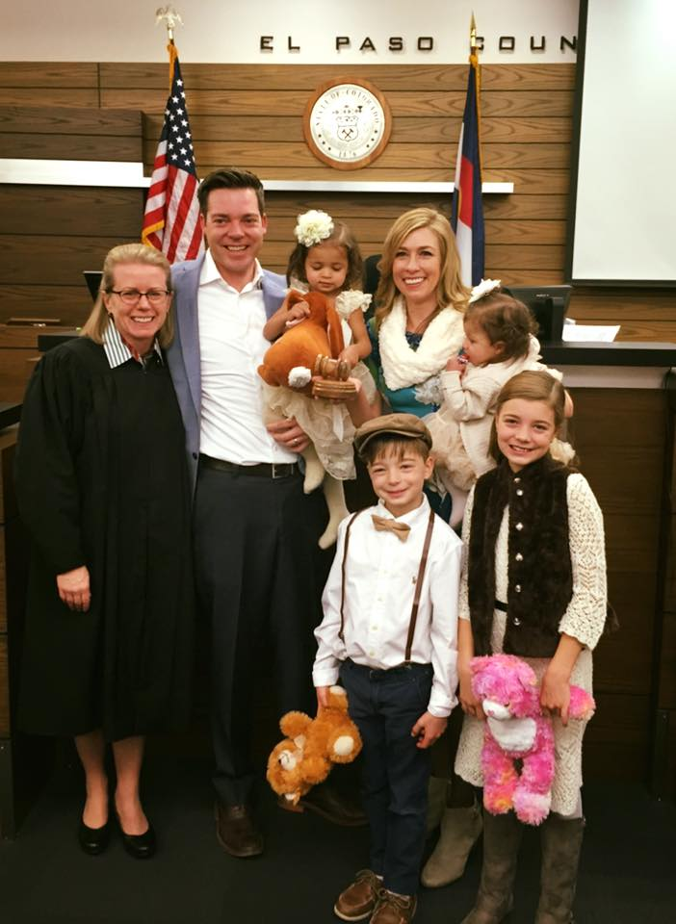
Our Adoption Day

Slide 16
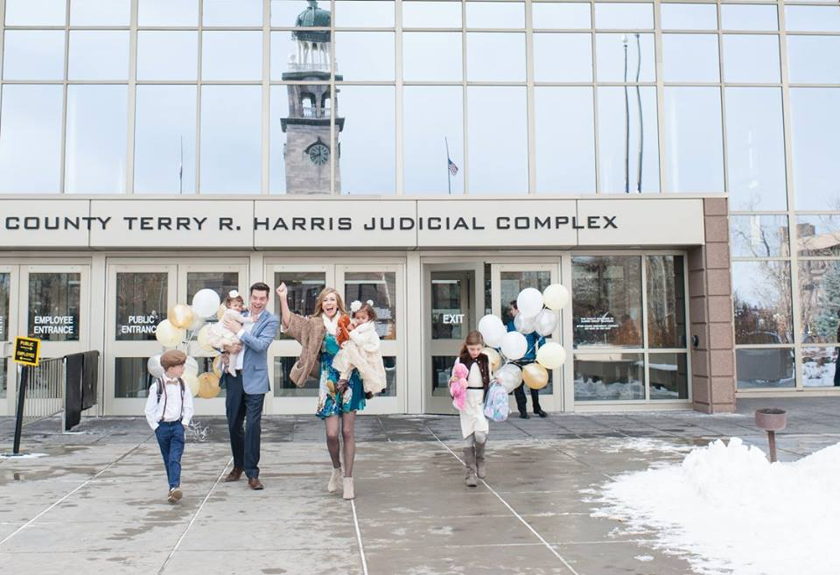
Our Adoption Day

